Slide 1


Adsorption and Release of Surfactant into and from Multifunctional Zwitterionic Poly(NIPAm-co-DMAPMA-co-AAc) Microgel Particles
Morgan Kelley
Haobo Chen
Dr. Lenore L. Dai
Ira A. Fulton Schools of Engineering
Arizona State University

Slide 2
Motivation and Goals
Oil spills are dangerous to marine life and the environment, and chemicals commonly used to disperse these spills can also be detrimental to aquatic health. This project develops a method of transporting these dispersants via Zwitterionic microgels (ZI-MG)
The goals of this experiment are to investigate the properties of ZI-MG dispersions and their capabilities as novel carrier systems by investigating their propensity for uptake and release of various surfactants.

Slide 3
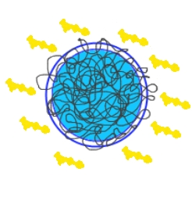
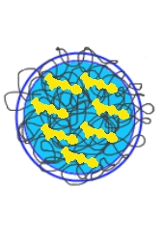

About ZI-MG
Environmentally responsive
pH
Temperature
Tunable parabolic size changes
Dually positive and negatively charged
Able to uptake and release active species into and from surrounding fluid

Slide 4
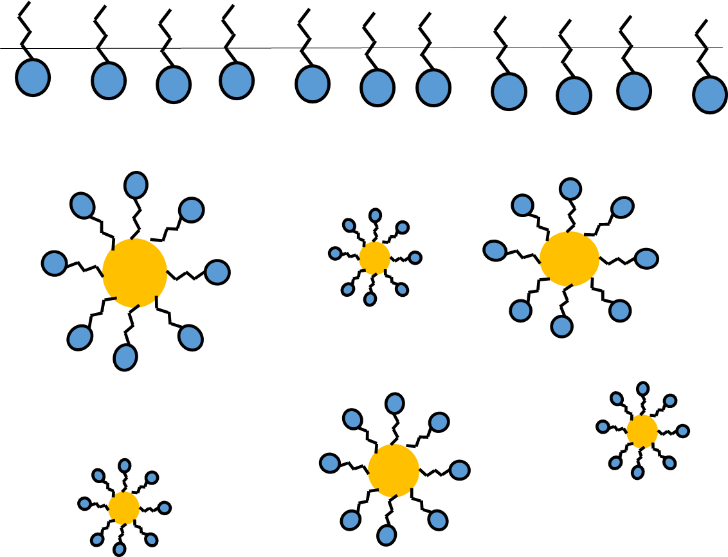
Surfactants
Surface Active Agents
Hydrophobic tail
Hydrophilic head
Cationic
Anionic
Nonionic
Lower the surface tension of water
Hydrophobic tails arrange around hydrophobic entities within the bulk

Slide 5
Methods: ZI-MG Synthesis
DMAPMA and AAc comonomers were copolymerized with NIPAm via free radical precipitation polymerization
DMAPMA, NIPAm, AAc, MBAm, SDS, and HPLC put in 3-neck round-bottom flask and degassed with nitrogen for 30 minutes
5g of HPLC with KPS initiator dissolved added after 30 minutes
Polymerization proceeded for 8 hours under nitrogen at 70ºC
Dialyzed against deionized water to remove unreacted monomers
Nitrogen Out
Water out
Water in
KPS in
Nitrogen in

Slide 6
Characterization of ZI-MG
Dynamic Light Scattering (DLS)
pH ramp
Temperature ramp
PSS-NICOMP 380 ZLS
Measures intensity of laser coming through particles
Particle size calculated by Stokes-Einstein in program
Zeta Potential (ZLS)
pH ramp
Measures electrophoretic mobility between electrodes
Electrophoretic Light Scattering

Slide 7
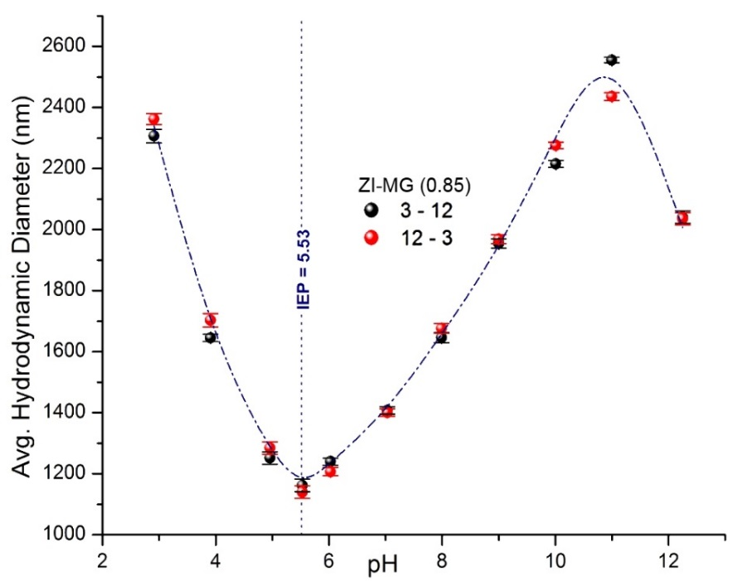
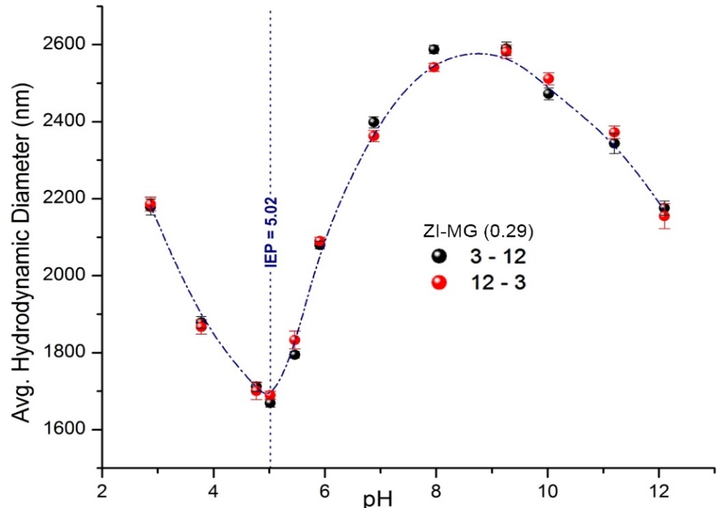
Characterization of ZI-MG: pH Responsiveness
Initial size decrease due to electrostatic attraction of AAc and DMAPMA
Charge neutralized at IEP
Past the IEP there is size increase due to electrostatic repulsion between AAc and DMAPMA
IEP for 0.85 is later than that of 0.29 due to increased DMAPMA and (more added base required to neutralize)

Slide 8
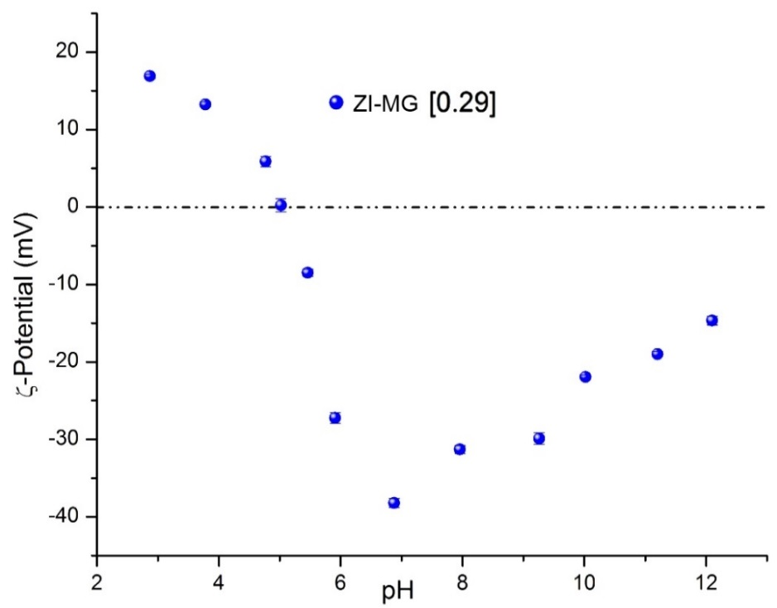
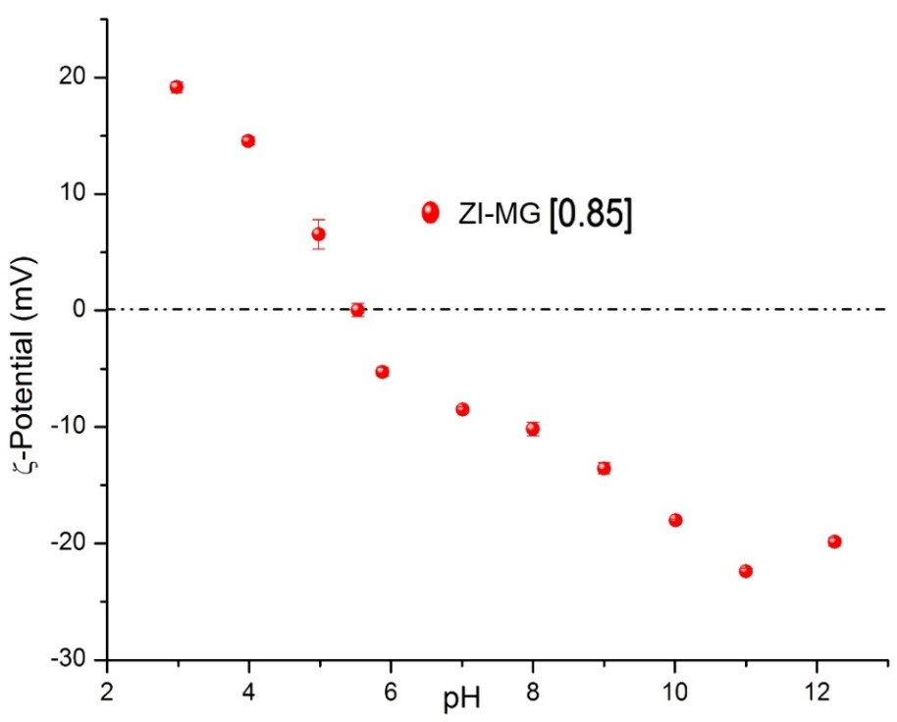
Characterization of ZI-MG: pH Responsiveness
Decrease in ζ-potential verifies size change prior to IEP
Charge neutralized at the IEP
ζ-potential decreases with pH due to deprotonation of both DMAPMA and AAc
ζ-potential increases with pH following IEP
Further deprotonation of AAc and DMAPMA results in repulsion
Notes:
Zwitterionic microgels decrease in size until the IEP where they show a minimum hydrodynamic diameter. Following the IEP, they increase sharply in size, levelling off and subsequently decreasing in particle size. The initial sharp decrease in size is due to electrostatic attraction, this is evidenced by the positive zeta potential of the particles prior to the IEP. When a base is added to raise the pH, the acrylic acid in the ZI-MG becomes unprotonated and causes electrostatic attraction with the DMAPMA particles until the IEP is reached. Once this point is reached, the charge on the particles is neutralized. Following the IEP, the size increases. This is due to further deprotonation of the acrylic acid and subsequent deprotonation of the DMAPMA which causes electrostatic repulsion and also increases the polarity of the ZI-MG allowing for more uptake of polar solvent.

Slide 9
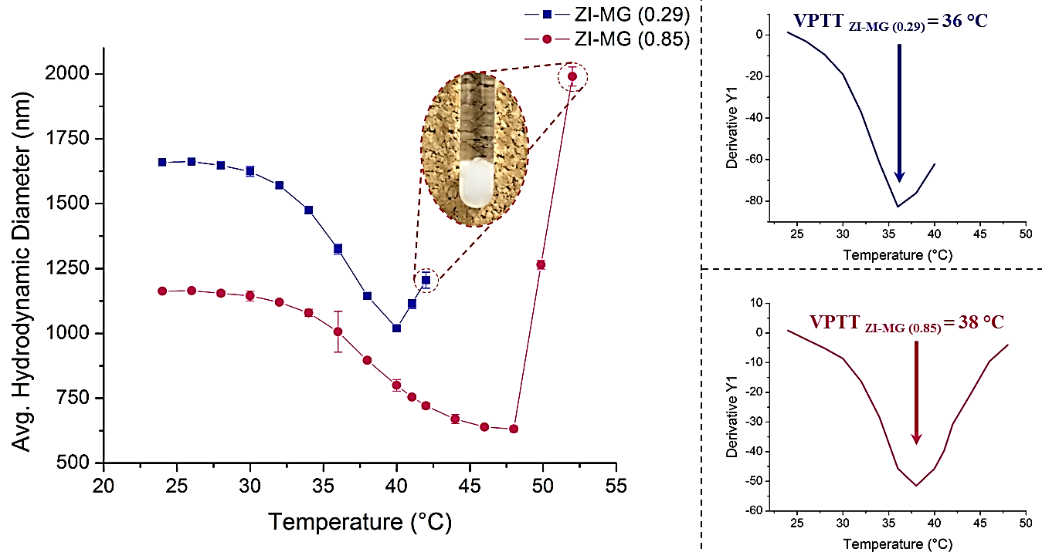
Characterization of ZI-MG: Temperature Responsiveness
Temperature transition and VPTT due to NIPAm
VPTT can be shifted by increasing DMAPMA:AAc ratio
0.85 has more gradual decrease
More balanced composition and stable ion pairs
0.29 has less ion coupling and is thus less stable
Notes:
To investigate the effects of composition on swelling, two different compositions of the microgels were made as shown in the table. As shown here, the .29 concentration has a sharper decrease in size with temperature increase than the .85 ZI-MG. the .29 has a slightly lower VPTT than the .85. This is because the 0.85 composition has a more balanced composition and thus forms more stable ion pairs while the .29 ZI-MG has less even ion coupling and thus less flexibility. Therefore, the VPTT is reached sooner and less smoothly.

Slide 10

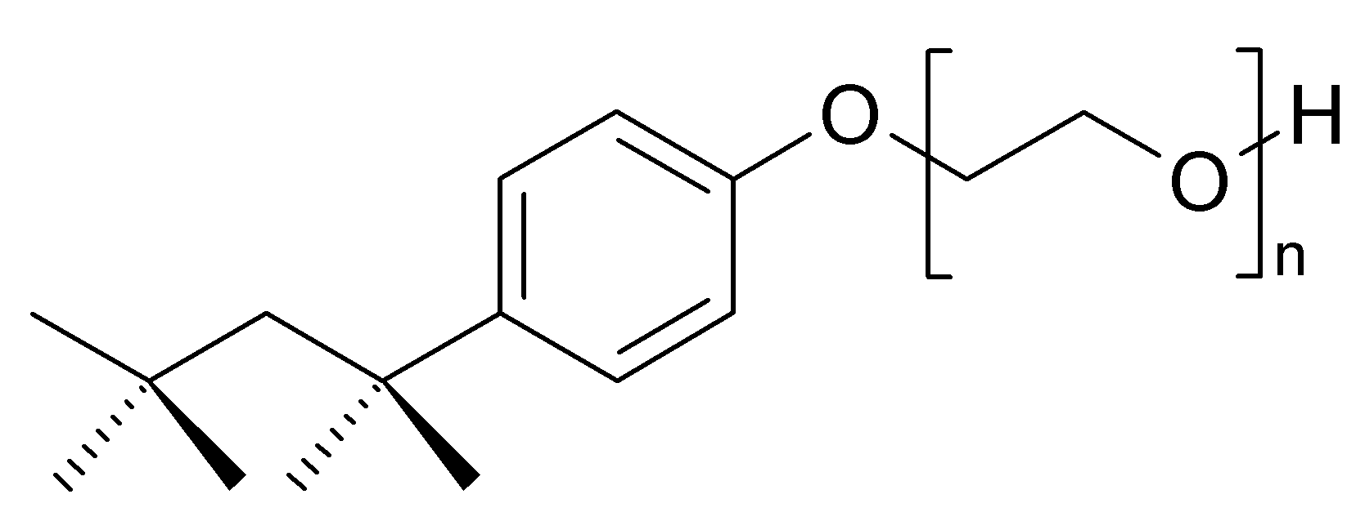
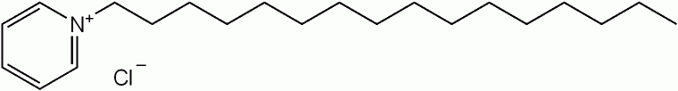
Materials: Surfactant Uptake
Anionic surfactant Dioctyl Sodium Sulfosuccinate (DOSS, Sigma-Aldrich),
Cationic surfactant Cetylpyridinium Chloride (CPyCl, Fluka) and
Nonionic surfactant TritionTM X-100 (TX-100, Sigma-Aldrich) were also used as received.
DOSS
TX-100
CPyCl

Slide 11
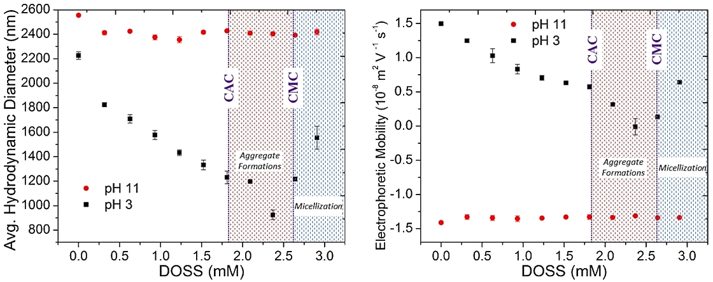
Surfactant Uptake: Anionic DOSS
Average size and electrophoretic mobility of pH 11 ZI-MG is unvarying with DOSS concentration
Size of pH 3 decreases with added DOSS
Electrostatic attraction of positively charged DMAPMA to DOSS
Swelling beyond CAC due to particle flocculation
Electrophoretic mobility decreases with added DOSS
Positively charged DMAPMA is neutralized by anionic DOSS
Electrophoretic mobility increase beyond CMC due to DOSS binding

Slide 12
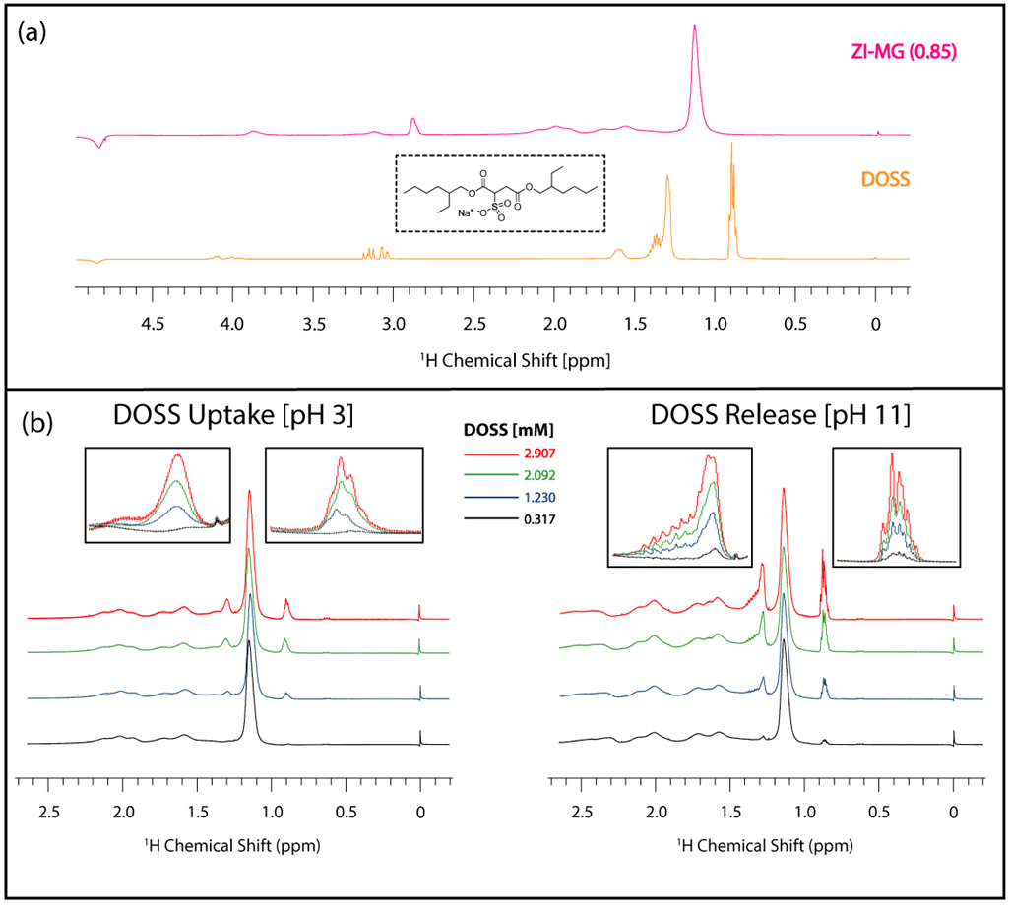
Surfactant Uptake and Release: Anionic DOSS
Notes:
Uptake spectrum (left) shows the characteristic methanol peak appearing just before 1.0 ppm
Shows DOSS absorption because it is the only peak in solution
Release spectrum (right) shows characteristic methanol and DOSS peaks
Shows DOSS release because both particles in solution

Slide 13
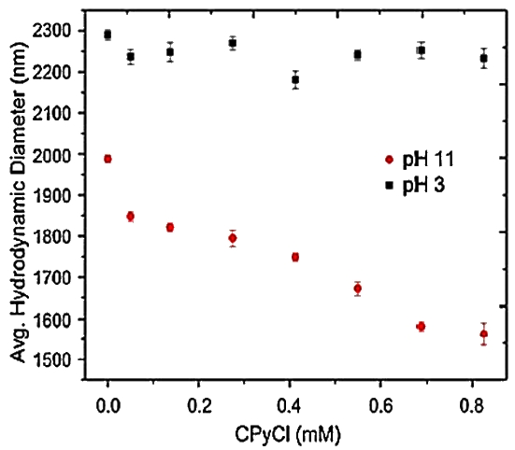
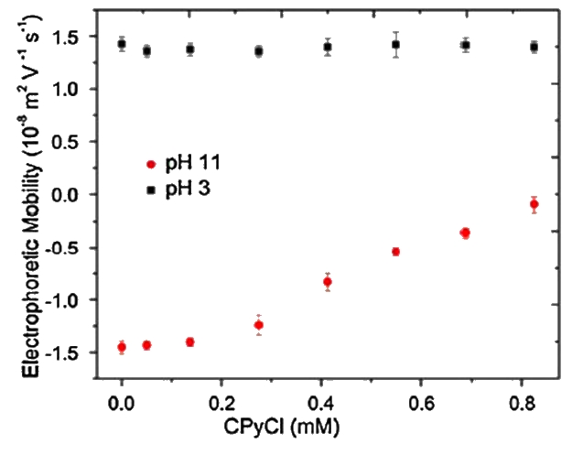
Surfactant Uptake: Cationic CPyCl
Diameter and electrophoretic mobility unvarying for pH 3
Diameter decreases with CPyCl for pH 11
Due to electrostatic attraction of negatively charged ZI-MG to CPyCl
Electrophoretic mobility increases with added CPyCl for pH 11
Solution becomes neutralized with enough added CPyCl due to ion pairing

Slide 14
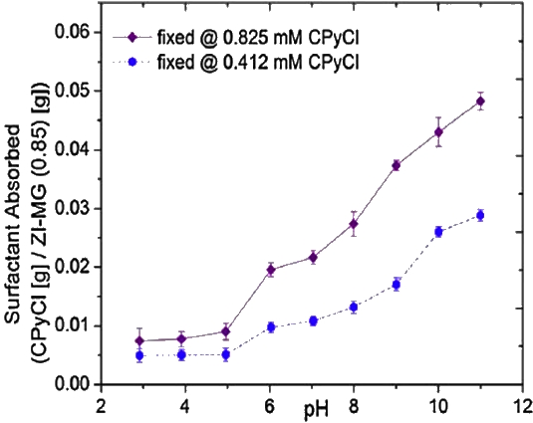
Surfactant Release: CPyCl
Fixed amount of CPyCl in solution
Decrease in pH shows that less surfactant was absorbed into ZI-MG
Since there is a fixed amount in solution, this denotes release
Higher fixed CPyCl concentration enabled more absorption

Slide 15
Conclusion and Future Work
ZI-MG particles were synthesized which change size and charge according to environmental stimuli
Cationic, anionic, and nonionic surfactants were studied for uptake capabilities
Cationic CPyCl was uptaken at pH 11
Anionic CPyCl was uptaken at pH 3 and released at pH 11
Future research:
Investigation of temperature effects on surfactant uptake
Synthesis of magnetic core-shell ZI-MG particles for easy removal from solution

Slide 16


Acknowledgements
Dr. Lenore L Dai and Haobo Chen
Colloid and Interfacial Science and Engineering Lab at Arizona State University
Research Funding:
Gulf of Mexico Research Initiative (GoMRI)
Fulton Undergraduate Research Initiative (FURI)
ASU/NASA Space Grant

Slide 17
Thank You!
Questions?

Slide 18
References
[1] |  | C. Zhao, X. Gao, P. He, C. Xiao, X. Zhuang and X. Chen, "Facile synthesis of thermo- and pH-responsive biodegradable microgels," Colloid and Polymer Science, vol. 289, no. 4, pp. 447-451, 2011.
[2] |  | R. Pelton and T. Hoare, "Highly pH and Temperature Responsive Microgels Functionalized with Vinylacetic Acid," Macromolecules, vol. 37, no. 7, p. 2544–2550, 2004.
[3] |  | H. Chen, M. Kelley, C. Guo and L. Dai, "Adsorption and Release of Surfactant into and from Multifunctional Zwitterionic Poly(NIPAm-co-DMAPMA-co-AAc) Microgel Particles," Journal of Colloid and Interface Science, pp. 1-10, 2015.
[4] |  | L. D. Haobo Chen, "Adsorption and Release of Active Species into and from Multifunctional Ionic Microgel Particles," Langmuir, vol. 29, no. 36, p. 11227–11235, 2013.
[5] |  | "Kiwi Web: Chemistry and New Zealand," Chemistry Co: New Zealand, 2011. [Online]. Available: http://www.chemistry.co.nz/surfactants.htm. [Accessed 6 March 2015].
[6] |  | N. Dhar, S. Parinaz, Akhlaghi and K. Tam, "Biodegradable and biocompatible polyampholyte microgels derived from chitosan, carboxymethyl cellulose and modified methyl cellulose," Carbohydrate Polymers, vol. 87, no. 1, pp. 101-109, 2011.
[7] |  | K. Johnson, F. Mendez and M. Serpe, "Detecting Solution pH Changes Using Poly (N-Isopropylacrylamide)-co-Acrylic Acid Microgel-Based Etalon Modified Quartz Crystal Microbalances," Analytical Chemistry, vol. 739, pp. 83-88, 2012.
[8] |  | Z. Farooqib, H. U. Khana, S. M. Shaha and M. Siddiq, "Stability of poly(N-isopropylacrylamide-co-acrylic acid) polymer microgels under various conditions of temperature, pH and salt concentration," Arabian Journal of Chemistry, 2013.
[9] |  | T. Ngai, S. Behrens and H. Auweter, "Novel emulsions stabilized by pH and temperature sensitive microgels," Chemical Communications, vol. 331, no. 3, 2005.
[10] |  | S. Bereswill, T. Vey and M. Kist, "Susceptibility in vitro of Helicobacter pylori to cetylpyridinium chloride," FEMS Immunology & Medical Microbiology, pp. 189-192, 1999.
[11] |  | M. Chiarini and C. Bunton, "Oxidation of Thioanisole by Peroxomolybdate in Alcohol-Modified Micelles of Cetylpyridinium Chloride," Langmuir, vol. 18, no. 23, p. 8806–8812, 2002.
[12] |  | D. Steffy, A. Nichols and G. Kiplagat, "Investigating the effectiveness of the surfactant dioctyl sodium sulfosuccinate to disperse oil in a changing marine environment," Ocean Science Journal, vol. 46, no. 4, pp. 299-305, 2012.
[13] |  | A. Chatterjee, S. Moulik, S. Sanyal, B. Mishra and P. Puri, "Thermodynamics of Micelle Formation of Ionic Surfactants: A Critical Assessment for Sodium Dodecyl Sulfate, Cetyl Pyridinium Chloride and Dioctyl Sulfosuccinate (Na Salt) by Microcalorimetric, Conductometric, and Tensiometric Measurements," Journal of Physical Chemistry B, vol. 105, no. 51, p. 12823–12831, 2001.

Slide 19
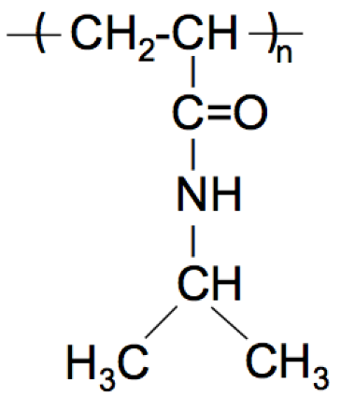
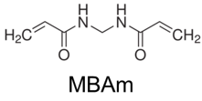
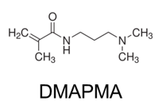
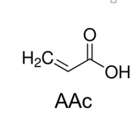
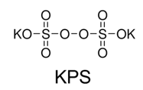
Materials: ZI-MG synthesis
Co-monomers
N-isopropylacrylamide (NIPAm, Acros)
N-[3-(dimethylamino)propyl] methacrylamide (DMAPMA, Sigma-Aldrich)
Acrylic Acid (AAc, Sigma-Aldrich)
Cross-linker
N,N’-methylene-bis-acrylamide (MBAm, MP)
Initiator
Potassium Persulfate (KPS, Acros)
Stabilizing Agent
Sodium Dodecyl Sulfate (SDS, Sigma-Aldrich)
NIPAm

Slide 20
Methods: Surfactant Uptake and Qualification
Known volume of surfactant solution mixed with 3mL ZI-MG dispersed in either pH 3 or 11 medium
Sonicated for 15 minutes
Left overnight on mild oscillation desktop shaker
For DLS left as above
For H¹ NMR and UV Vis
ZI-MG were centrifuged and the supernatant was extracted
Particles were re-dispersed in HPLC water
Solution depletion method: supernatant measured and amount determined to be un-absorbed amount
ZI-MG Supernatant
ZI-MG Pellet

Slide 21
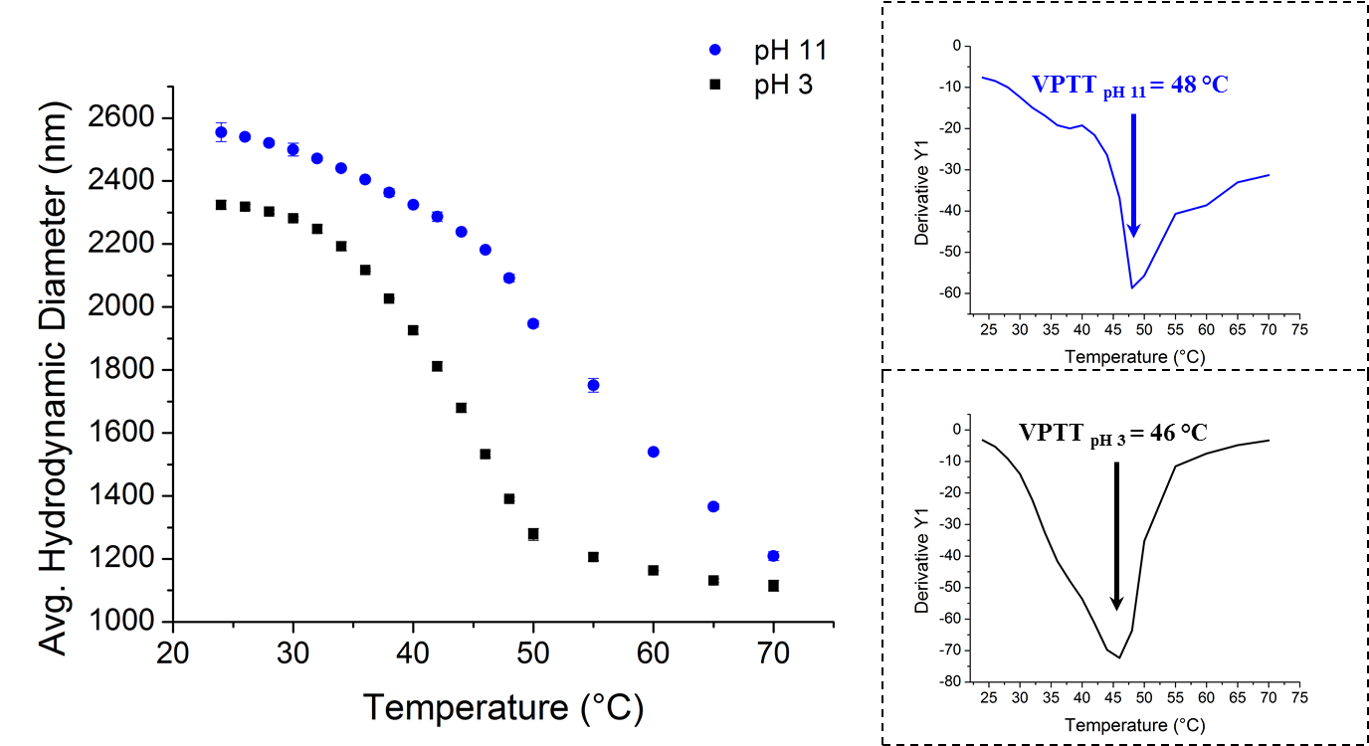
Characterization of ZI-MG: Temperature Responsiveness
Average size at pH 11 larger than at pH 3
More deprotonation of AAc and DMAPMA
Causes electrostatic repulsion
Hydrophilic attractions cause pH 3 particles to be smaller
VPTT of pH 3 is at lower temperature
Due to the sharper size change at pH 3 compared to pH 11
Notes:
Average size of ZI-MG at pH 11 is substantially larger than that of the ZI-MG at pH 3. At pH 11, there is more deprotonation of both the acrylic acid and the DMAPMA which causes electrostatic repulsion and an overall larger hydrodynamic diameter. In contrast, the ZI-MG at pH 3 are much smaller due to hydrophilic interactions within the particles. As shown, the VPTT of the pH 3 particles is lower and sharper than the VPTT of the pH 11 particles. This could be due to

Slide 22
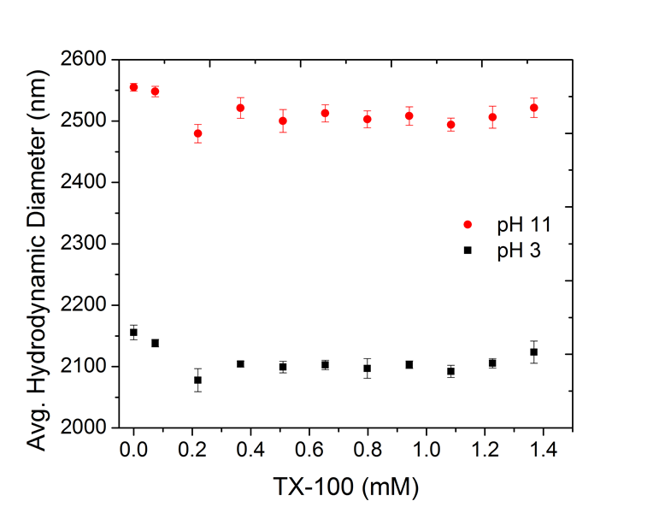
Surfactant Uptake: Nonionic TX-100
Diameter remains relatively unvarying, independent of TX-100 in solution.
Shows that little to no uptake of TX-100 occurred

